Slide 1



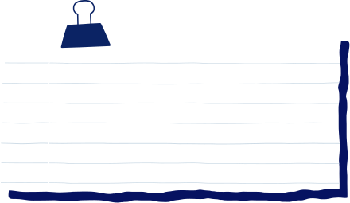


URBAN AIR QUALITY WEB PAGE
Presented by Shravya

Slide 2
OVERVIEW
• Abstact
• Problem Statement
• Introduction
• Objectives
• Methodology
• Literature Survey
• Gap Analysis
• Comparitive Analysis
• Results
• Conclusion
• Reference

Slide 3
ABSTRACT
Urban air pollution is a major environmental and health issue. This project analyzes pollutant data (PM2.5, PM10, NO₂, SO₂, CO, O₃) using datasets from Indian cities. A responsive web platform was developed to display real-time AQI, track health symptoms, and suggest personalized precautions. Features like heatmaps, charts, and a community forum make it informative and interactive, aiming to reduce pollution impact and raise public awareness.

Slide 4
PROBLEM STATEMENT
Air pollution in urban areas has reached critical levels due to industrial growth and urbanization. This results in severe health risks, including respiratory and cardiovascular diseases. Existing monitoring systems lack accessibility, real-time personalization, and public engagement. Our project addresses these gaps through a web-based platform that analyzes air quality and its health effects.

Slide 5
INTRODUCTION
Millions are exposed daily to poor air quality in cities, leading to serious health consequences. Our project provides users with tools to monitor pollution levels, understand their health impact, and receive actionable guidance. The integration of data analytics and web technologies helps users make informed, health-conscious decisions.

Slide 6
OBJECTIVES
Analyze key pollutants and their trends
Develop a responsive website to display AQI and health data
Map real-time pollution levels across regions
Provide symptom-based health analysis
Offer personalized precautions and community interaction

Slide 7
METHODOLOGY
Data Collection & Processing
Collected air quality data from Kaggle's Urban Air Quality and Health Impact dataset
Cleaned missing values, standardized units, and mapped data to Indian regions and timestamps
Website Development
Designed using HTML, CSS, JavaScript with responsive layouts
Implemented interactive UI elements: dropdown for regions, symptom form, and pollution cards

Slide 8

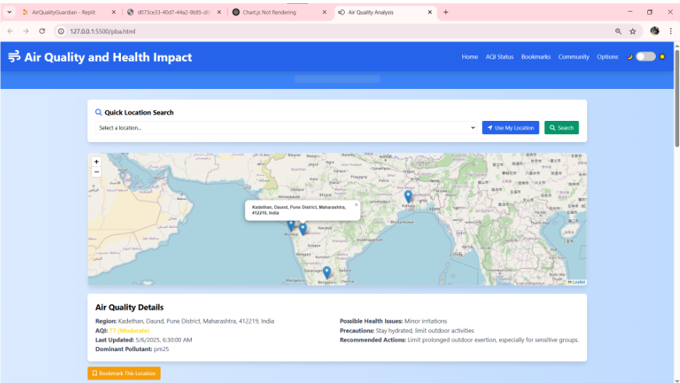
RESULTS

Slide 9
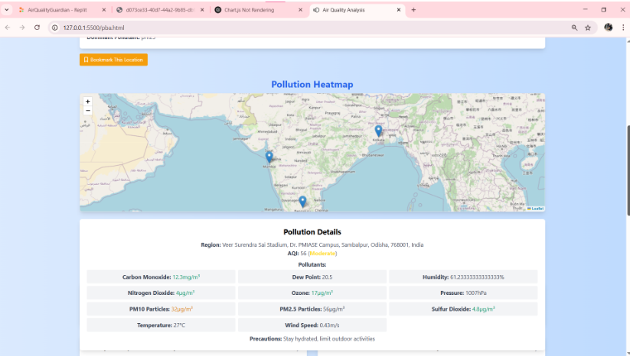
RESULTS

Slide 10
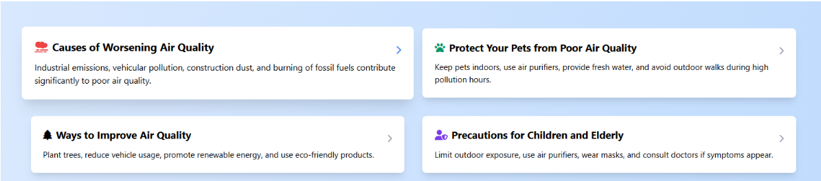
RESULTS

Slide 11
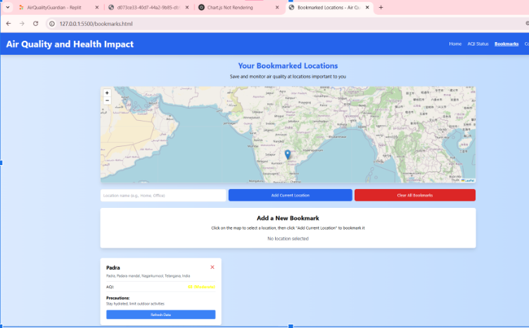
RESULTS

Slide 12
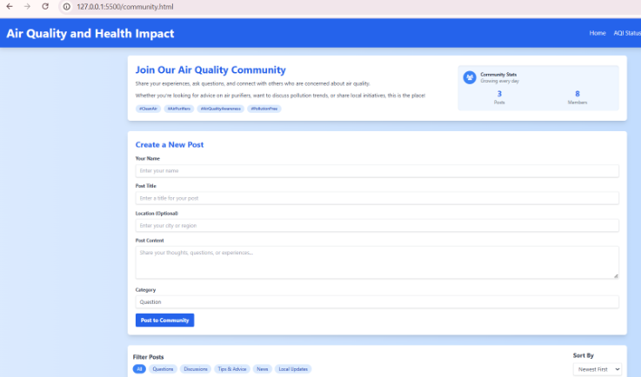
RESULTS

Slide 13
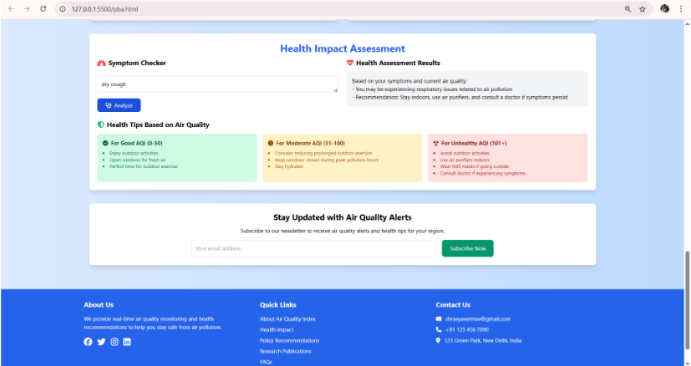
RESULTS

Slide 14
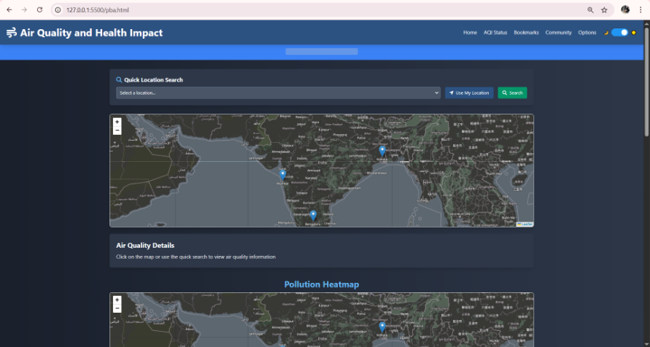
RESULTS

Slide 15
CONCLUSION
This project transforms air quality data into meaningful insights, making pollution monitoring more accessible and actionable. By integrating AI, geospatial analysis, and user engagement, it not only raises awareness but also provides real-world solutions, empowering individuals to safeguard their health in an increasingly polluted environment.

Slide 16
REFERENCE
Health Effects of Fine Particulate Air Pollution: Lines that Connect.
Authors: C. Arden Pope III and Douglas W. Dockery
Published in: Journal of the Air & Waste Management Association, 2006
Estimates and 25-Year Trends of the Global Burden of Disease Attributable to Ambient Air Pollution: An Analysis of Data from the Global Burden of Diseases Study 2015
Authors: Aaron J. Cohen, Michael Brauer, Richard Burnett, et al.
Published in: The Lancet, 2017
Urban and Transport Planning Pathways to Carbon-Neutral, Livable and Healthy Cities: A Review of the Current Evidence
Author: Mark J. Nieuwenhuijsen
Published in: Environment International, 2016

Slide 17
THANK YOU
Presented by Shravya

